Slide 1

Informed Choice:
It’s More Than Just Asking
David Hoff
Institute for Community Inclusion, UMass Boston
david.hoff@umb.edu
617-480-9230
www.communityinclusion.org

Slide 2
Handouts
Presentation Outline
Publication: Employment and Employment Supports:
A Guide to Ensuring Informed Choices for Individuals with Disabilities

Slide 3
If you would like copies of the PowerPoint slides, please email david.hoff@umb.edu

Slide 4
Robyn Lewis
Employment Practices That Sustain the Competitive Employment for Individuals with Intellectual Disabilities: Employers’ Perceptions
“Instead of sitting in the driver’s seat and being placed at the center of the decision-making process, a traditional support model for employment places the individual with intellectual and developmental disabilities on the sidelines while critical supporters (parents, teachers, adult agencies, legislators, and policy makers) are working in their respective silos, laterally determining the next or best ‘place’ for the individual. We must understand that no great good can be done for a people if we do not listen to them first. The wants and needs of employers and individuals with intellectual disabilities need to be heard by the people and systems which support them. We must provide a voice to those who do not have one. Individuals with intellectual and developmental disabilities often do not independently self-advocate even when provided significant training in advocacy. They rely on allies to speak up and act on their behalf. Persons with intellectual and developmental disabilities must be supported to make informed choices about employment and have the resources to seek, obtain, and be successful in community employment.”

Slide 5

“Listen to our dreams about having a job.
We want to work just like others.”
Stirling Peebles

Slide 6

Consider
What was the decision regarding your current job based on?
What was the decision regarding your career based on?

Slide 7

Choice

Slide 8
What makes a choice an informed choice?

Slide 9
Informed Choice: Some Basic Truths
Professionals always believe they are facilitating informed choice.
Informed choice is a much more complex and nuanced process, than typically recognized.
Informed choice is mentioned throughout federal law,
but is not defined.

Slide 10

Informed Choice Definition

Slide 11
Informed Choice Requires:
skills and experience in making choices
experience that we can draw on
a culture that embraces informed choice
a tolerance for reasonable risks and failure

Slide 12
The challenge of informed choice for people with disabilities
Limited experiences on which to base decisions
Limited opportunities for choice making
A culture that too often defers to others regarding individual choices

Slide 13

Andraéa LaVant
Impact Producer, Crip Camp
“Everybody else in life gets the
opportunity to make mistakes.
You go out on your own, but because disabled people are often sheltered and other people are making decisions for us,
we don't have those opportunities to live completely wholly in that way.”

Slide 14

Variables Impacting Choice
Experience
Social
Expectations
Societal Expectations
Peers
Authority Figures
Culture

Slide 15

Examples of “Un-Informed” Choice

Slide 16


Not Informed Choice
NOT INFORMED CHOICE
Do you want to work in the community?

Slide 17

Discussion
Does informed choice mean you can do whatever you want?

Slide 18
People with disabilities are entitled to same level of choice as everyone else

Slide 19
Why informed choice matters

Slide 20

It’s the right thing and fundamental to our work
Self-determination
Self-advocacy
Person-centered planning

Slide 21
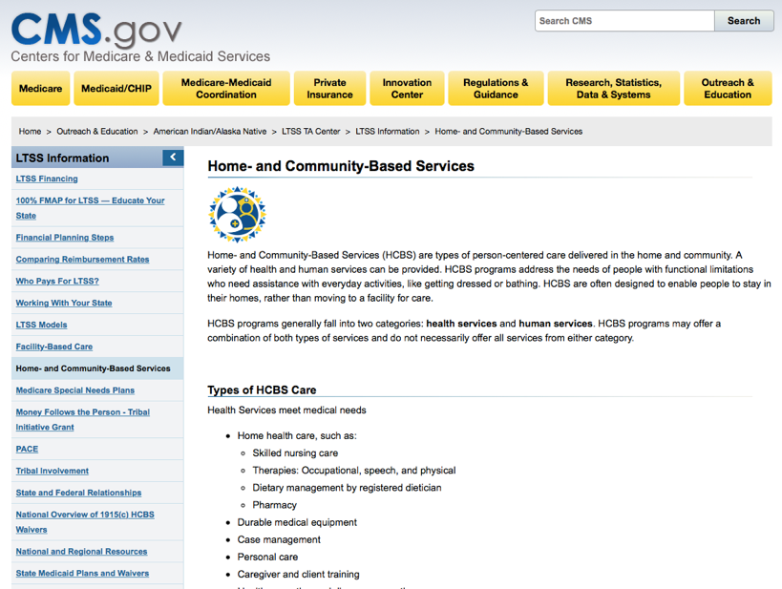

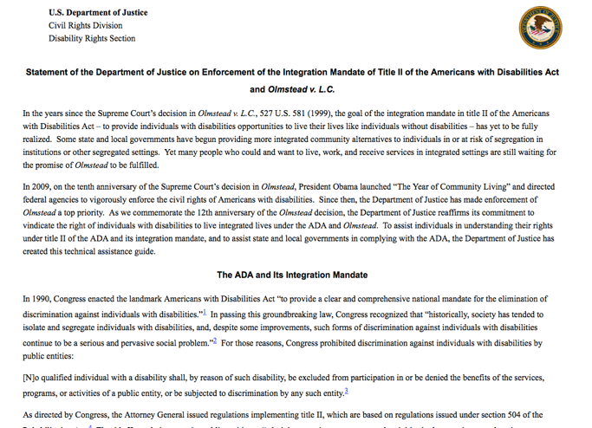
It’s the Law
WIOA:
VR Requirements, Section 511

Slide 22

Informed Choice Applies to ALL Aspects of Employment
Whether to work
Where to work
Type of job
Hours & schedule
Transportation
Changing jobs
Job accommodations & supports
Benefits
Others

Slide 23
Steps for Informed Choice & Employment
(based on Olmstead)
1. Provide information about benefits of working in the community
2. Facilitate visits to employment settings & similar experiences
3. Peer-to-peer discussions
4. Identify & address any concerns or objections raised by individual or relevant decision maker
5. Regularly revisit a decision about not working in the community

Slide 24

1. Provide information about the benefits of working in the community
What information?
How should it be provided?

Slide 25






2. Facilitate/arrange visits or other experiences in employment settings
Types of experiences
Ensuring quality experiences and sufficient experiences
Helping individuals process what they learn

Slide 26

3. Peer-to-Peer
Discussions
Who?
How?

Slide 27
4. Identify and address any concerns or objections raised by the individual or relevant decision maker
Common concerns & objections
Responses
Acknowledge concerns
Identify strategies for addressing

Slide 28
5. Regularly revisit a decision not to work in the community
Low-risk strategies to help inform individual and consider employment as an option

Slide 29

Importance of documentation
Steps to be taken
Concerns and issues and how they will be addressed

Slide 30
Informed Choice as a Developmental Process
Adapted from:
Informed Choice & Employment, Minnesota Department of Human Services, 2016
Work Change
Searching
Preparatory
Contemplative
Pre-Contemplative
Working

Slide 31






Ensuring understanding of “working”
Don’t presume individuals know what “working” and being “employed” really means.
Spend time in pre-contemplative & contemplative stages helping individuals understand wide range of possibilities regarding employment & possible impact on their lives.

Slide 32

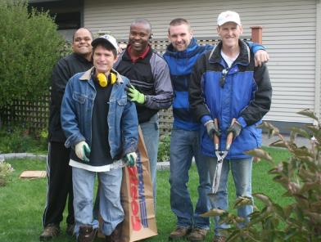
Is choosing a less preferred option okay?

Slide 33


Everyone needs to be on the same page

Slide 34



The Role of
Families
Understand their role
Keep them informed about each step
Respond to concerns
Remind them:
  It’s about exploration of options
  It’s about the individual’s choices and preferences
This Photo by Unknown Author is licensed under CC BY-ND

Slide 35
The Role of Guardians
What are the parameters of the guardianship?
Type and level of relationship with individual?
Involve guardian, and advocate for support of informed choice

Slide 36

National Guardianship Association Standards of Practice

Slide 37

Discussion:
What is the role of professionals?
Recommend?
Guide?
Advise?
Facilitate?

Slide 38

The role of the professional is to create and facilitate the ideal circumstances for individuals to make their own choices and decisions regarding employment

Slide 39

Should staff remain neutral?

Slide 40


Required Staff Skills
Skilled listening
Cultural awareness and competency regarding choice-making
Influence & impact of staff values and personal values on choice-making
Empowering individuals to direct their own process
Managing conflict

Slide 41

What professionals say and how they say it is important
What statements that can help with choice?
What statements can hinder choice?

Slide 42
Programmatic Considerations
Culture that encourages informed choice
Supporting individuals with communication challenges and other support needs
Ensuring exposure to a variety of work settings to inform choice making process
Procedures for documentation of choice making process
Requirements for periodic review of decision not to pursue employment

Slide 43
Discussion
Given the context of professionals
“in charge”, how do we promote a culture of informed choice?

Slide 44

Wrap-Up

Slide 45

Resources
Resources

Slide 46

DARS Supporting Informed Choice About Employment

Slide 47

New Jersey Pathway to Employment

Slide 48

Minnesota Toolkit to Support Informed Choice in Employment

Slide 49

Minnesota Legislation on Informed Choice
This Photo by Unknown Author is licensed under CC BY-SA
Specifically addresses employment

Slide 50

“Presume competence.
And what we mean by presuming competence is when you meet a person with a disability you assume they are capable.
Don’t assume that someone can or can’t do things but make sure they tell you what they need for accommodations and give them the chance to be in the driver’s seat.”
Max Barrows
Green Mountain Self-Advocates

